Slide 1
Wind energy

Slide 2




About us
Fawn Zou
Lee Gao
Steve Darby
Vien Vo

Slide 3
Questions
Requirements for suitable location for wind farms.
Which states have most locations suitable for wind farms?
Where to build wind farm?
Which states benefit most from wind energy?

Slide 4
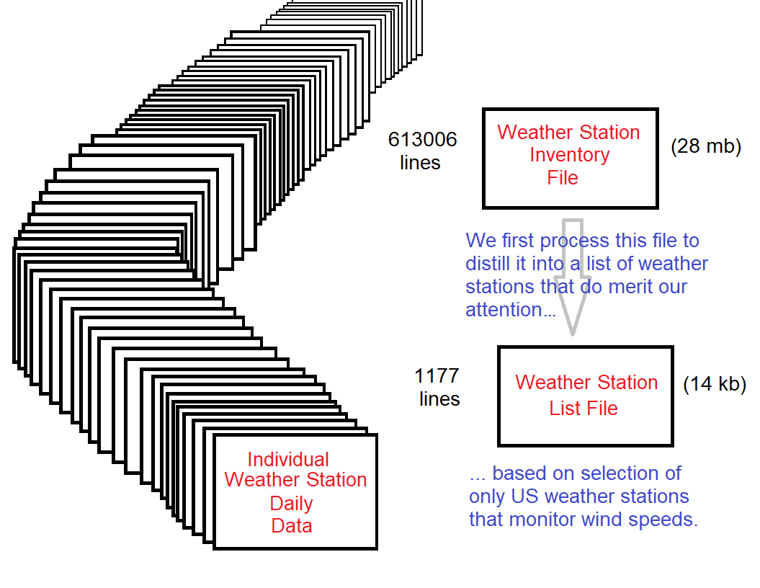
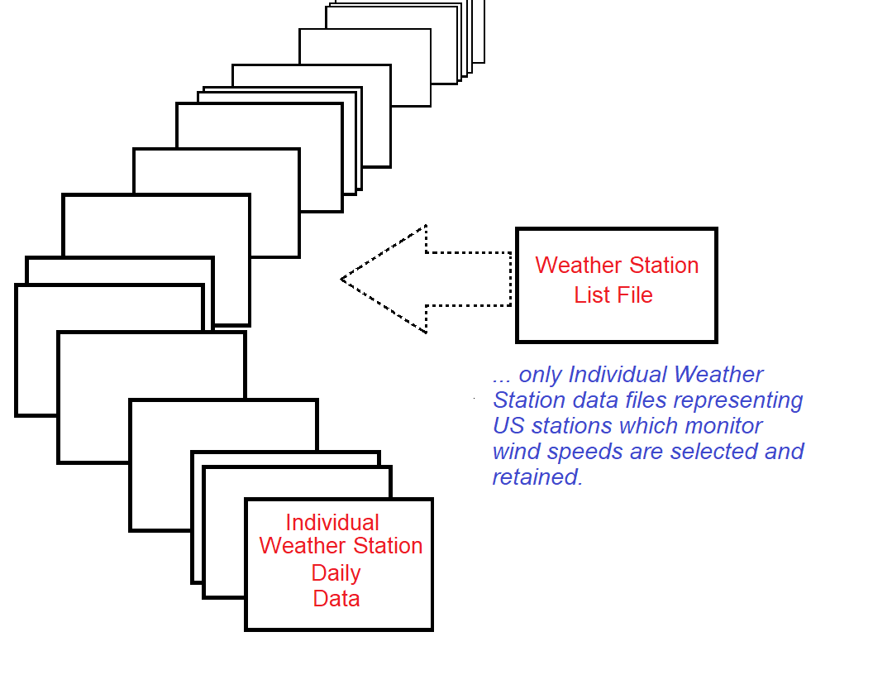
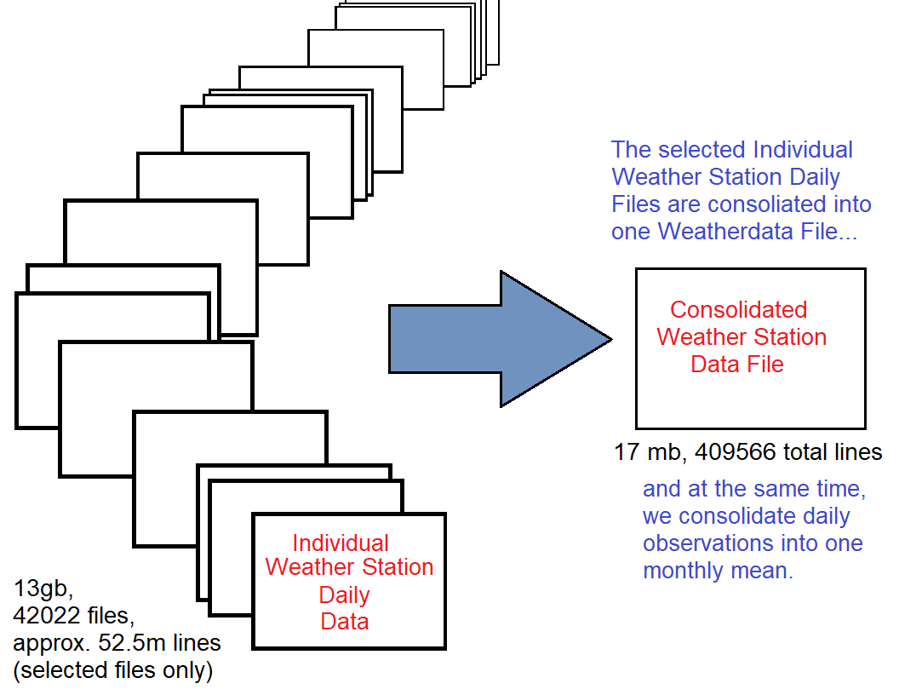
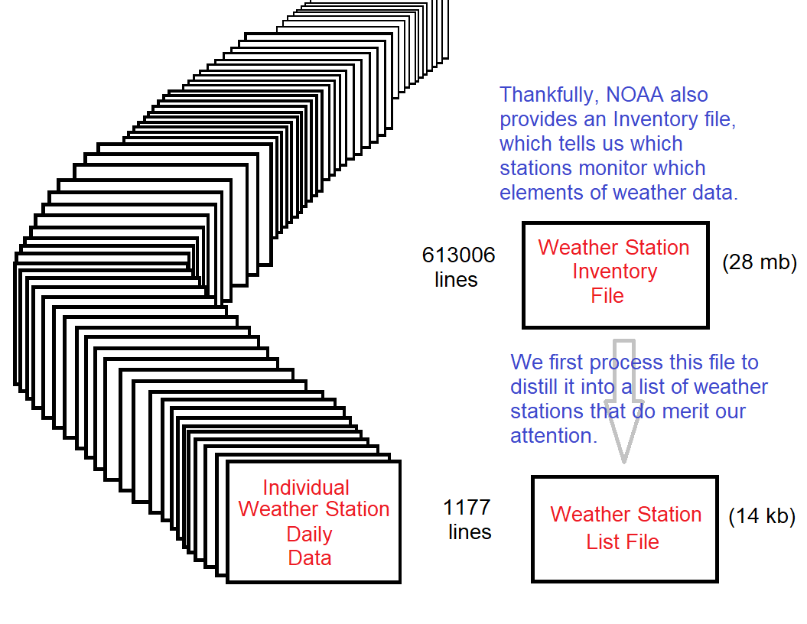
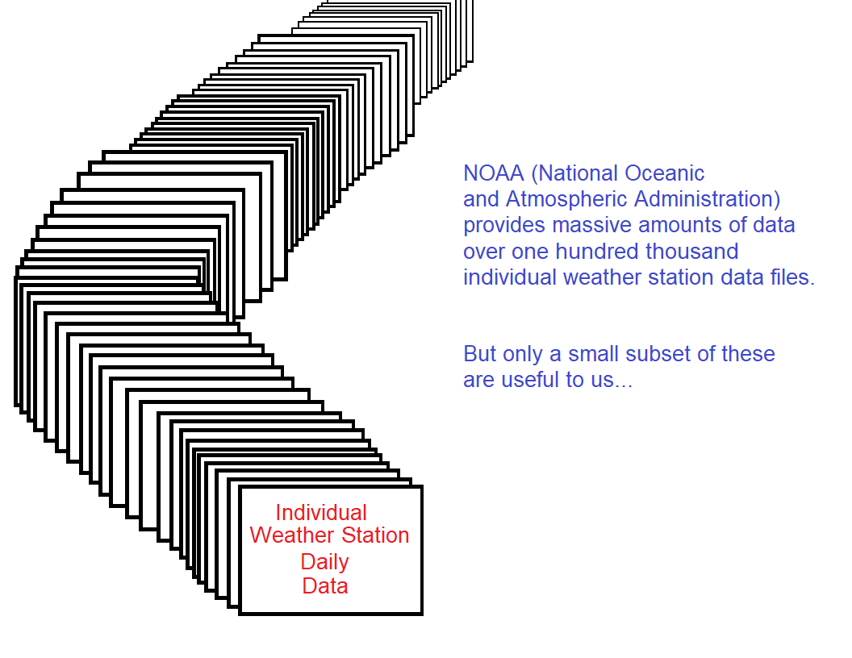
Data gathering and cleaning

Slide 5
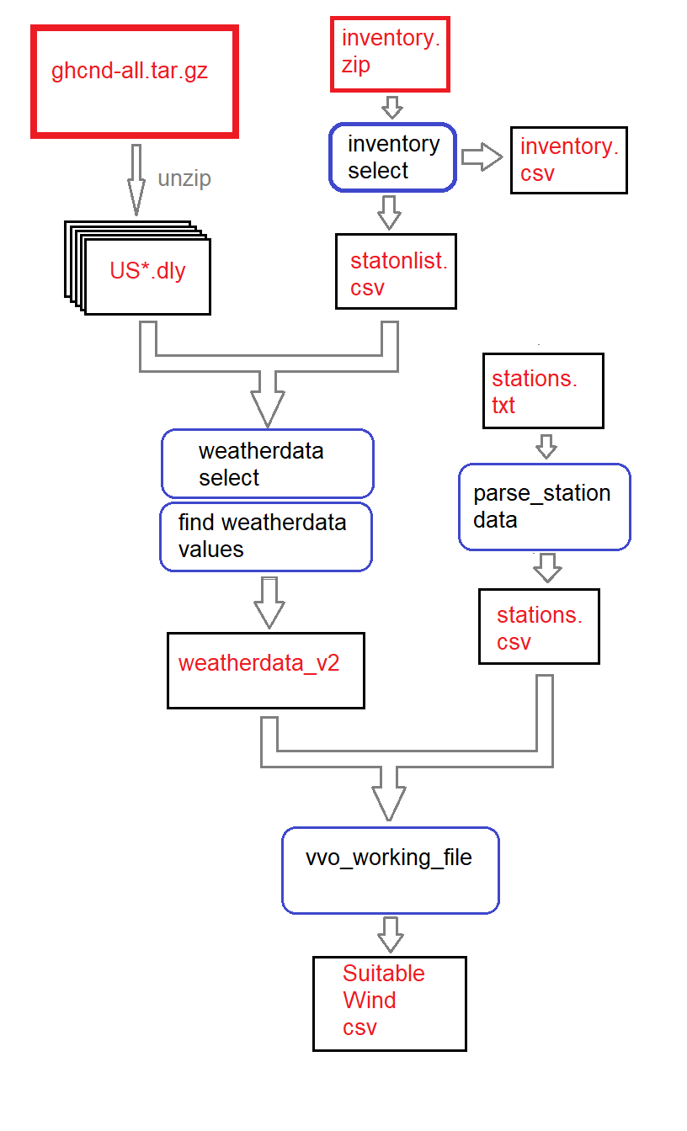
Data Flow

Slide 6
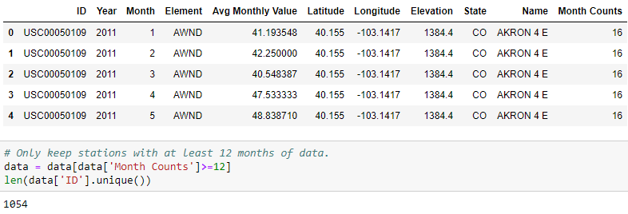
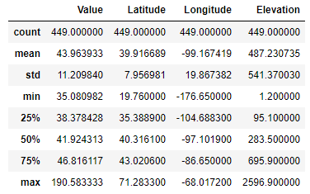
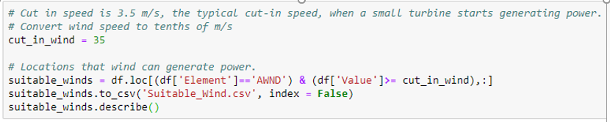
Requirements for wind farms.
8 kph (2 m/s) minimum is required to start rotating most small wind turbines.
12.6 kph (3.5 m/s) is the typical cut-in speed, when a small turbine starts generating power.
36–54 kph (10–15 m/s) produces maximum generation power.

Slide 7
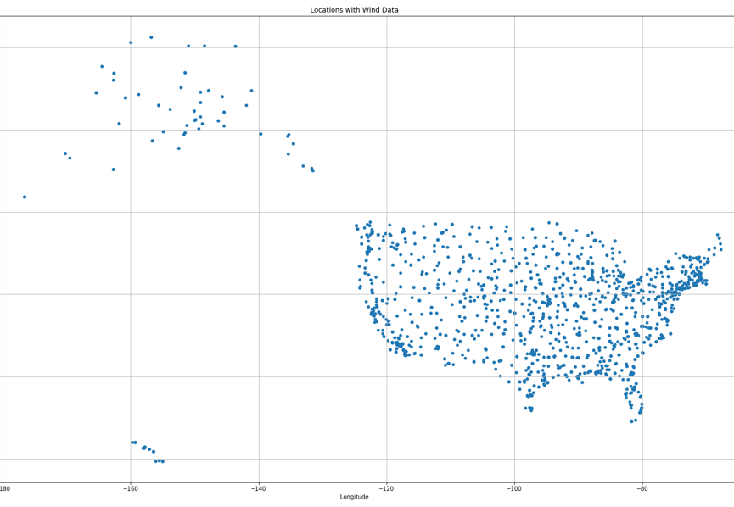
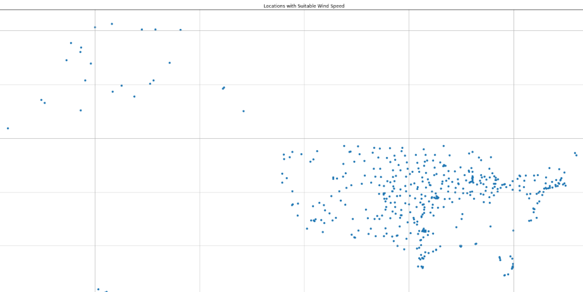
U.s. locations with wind data
U.s. locations suitable wind speed
1054
12.6 kph (3.5 m/s) is the typical cut-in speed, when a small turbine starts generating power.
449

Slide 8
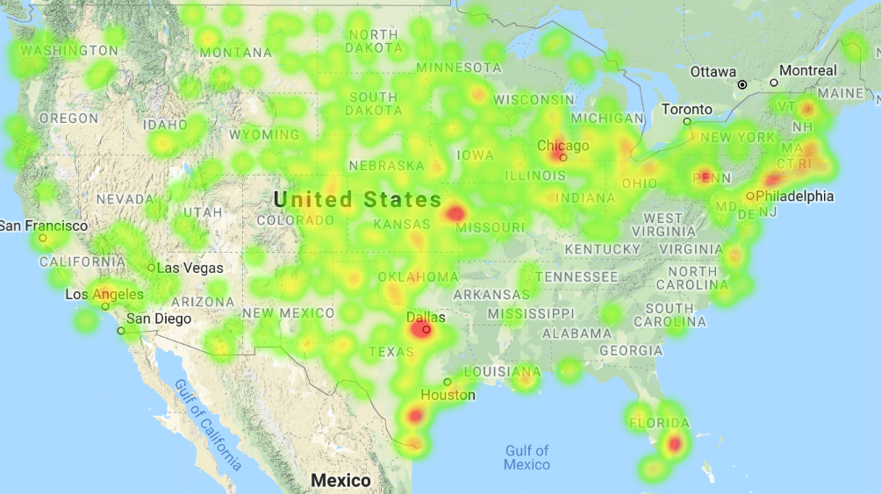
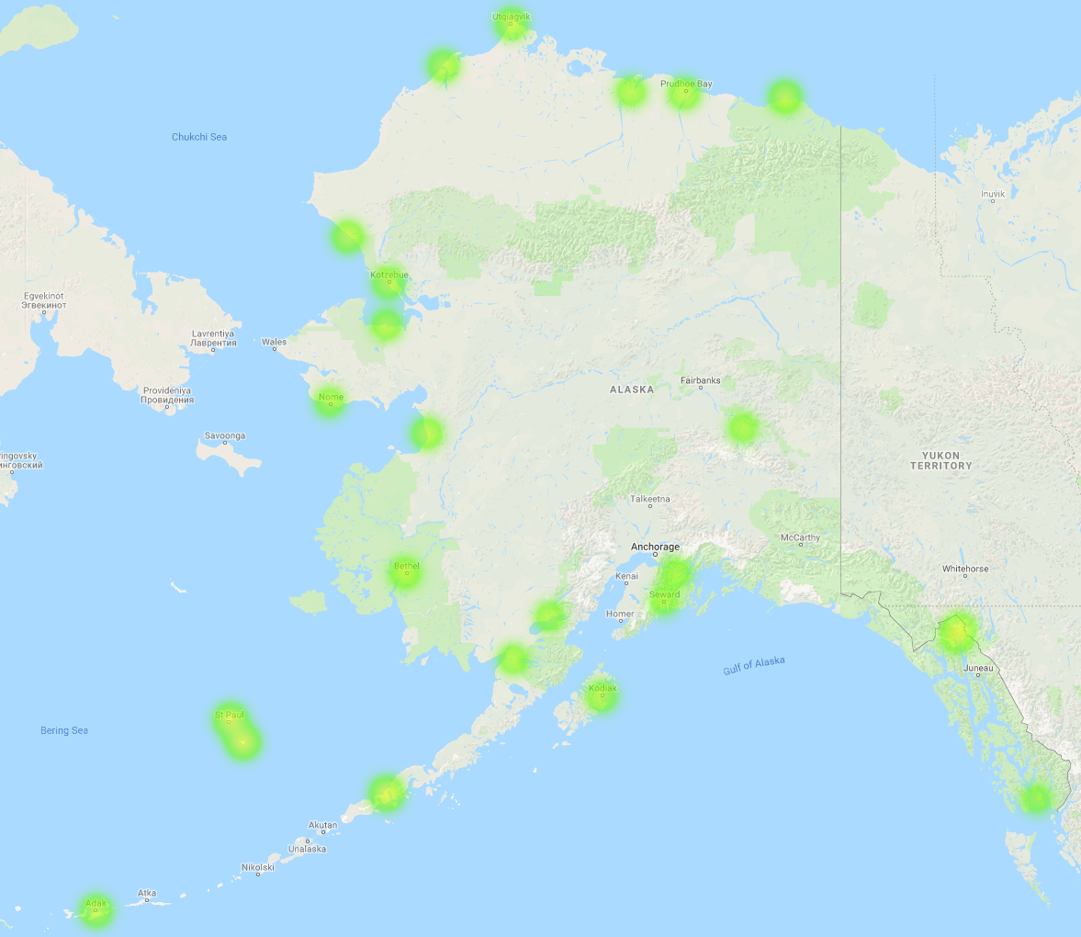
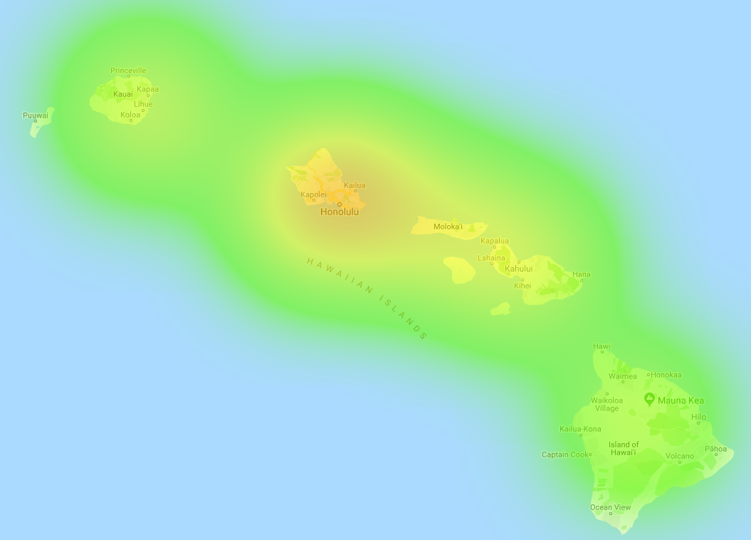
Suitable locations for wind farms?

Slide 9
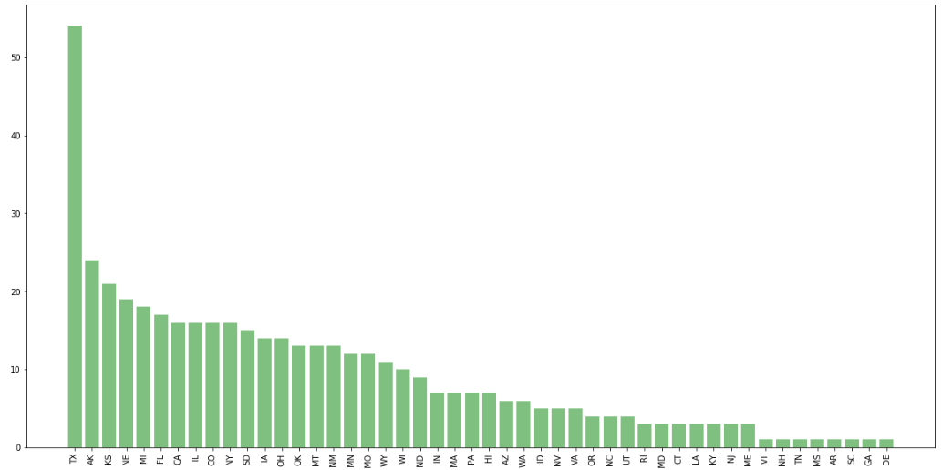
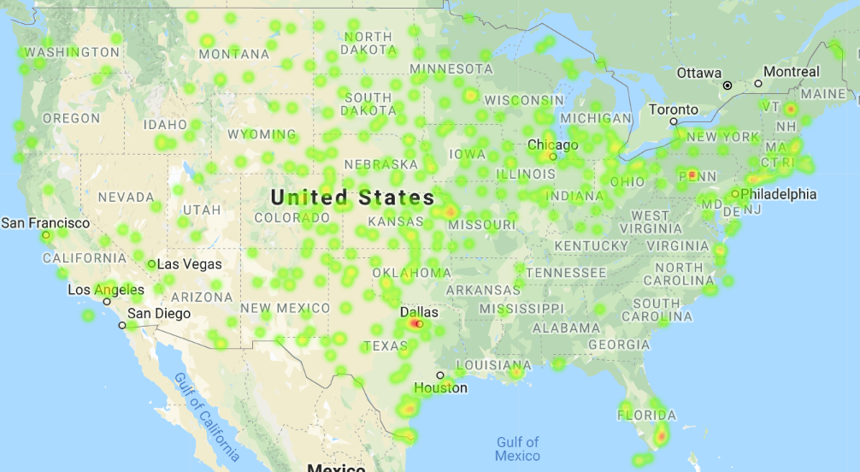
List of States with suitable wind speed

Slide 10
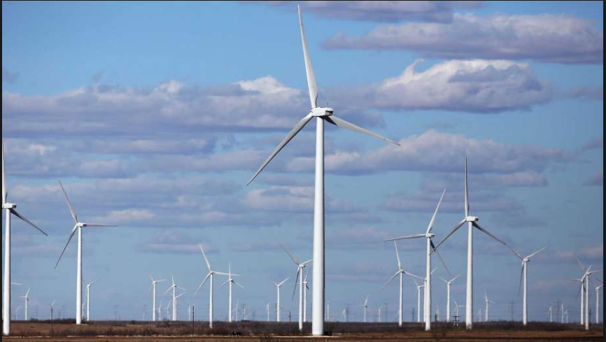
Midland, texas

Slide 11
Challenges of Wind Farm Construction
- Human impact (population density, psychological impacts)
- Social impact, local and regional economic and economic conditions;
- Local environmental impact
Power grid network
etc.

Slide 12
Population Density of 449 Locations
Identify the nearest city/town/ name based on latitude/longitude
Pull the population density data from Gmap API
Keep the location with population density less than 500 per square miles
Visualize with heatmap

Slide 13
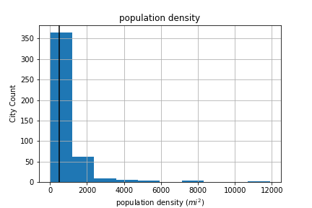
Population Density Distribution

Slide 14
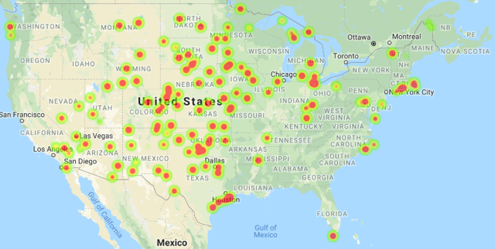
Locations with Population Density <= 500 (per square mile)
449
161
Population Density <= 500

Slide 15
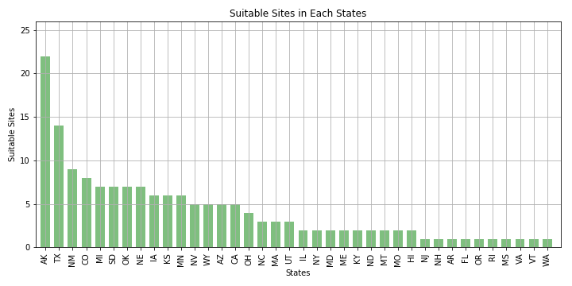
Suitable sites counts for each state

Slide 16

Wind Turbine Locations with Climate and Health Benefits
“A wind turbine in West Virginia displaces twice as much carbon dioxide and seven times as much health damage as the same turbine in California.” Kyle Siler-Evans, Ph.D. researcher from Carnegie Mellon University .

Slide 17
We Investigate the Coal Consumption in Each State in 2014
Dataset : United States Energy, Census, and GDP 2010-2014.csv
The 2010-2014 US Energy, Census, and Economic data
Here I only retrieve Coal total consumption for each state in 2014 (All of data from U.S Energy Information Administration)

Slide 18
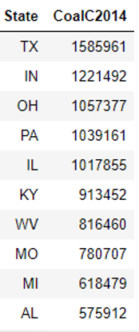
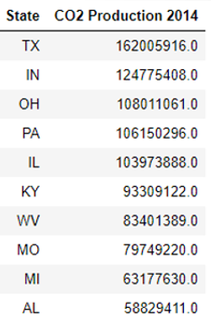
Coal total consumption
in billion BTU in 2014
Carbon Dioxide Production(ton)
Btu :British thermal units
Coal with a carbon content of 78 percent emits about 204.3 pounds of carbon dioxide
per million Btu when completely burned.
2000 lb/ 1 tons
“CoalC2014” * 204300/2000 = “CO2 Production 2014”

Slide 19
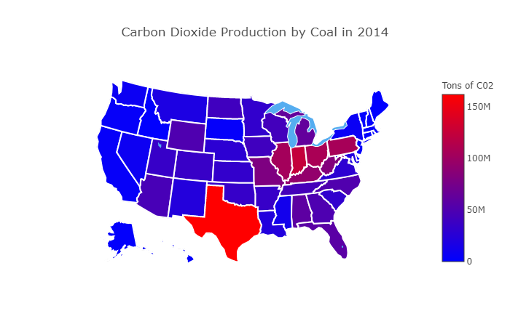

Slide 20
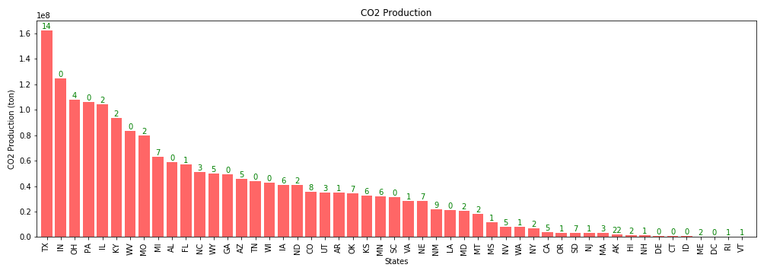
Combine Two Datasets
Wind farms result in greater health and climate benefits in states by replacing CO2 from big coal users such as Texas, Ohio, Illinois, Kentucky, and etc.

Slide 21
Conclusion
Texas can benefit greatly from wind energy: has the wind, has the land.
Data limitation

Slide 22
Question?

